Slide 1
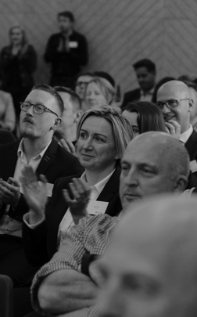

Whisper Down The Lane
Aramco
Group Members’: Lyon Simic, Alexander Burton, Daniel Meakes and Jinhao Zhang
Client Delegates’: Raghad Albarqi and Mark Ashmore
1st February 2023

Slide 2
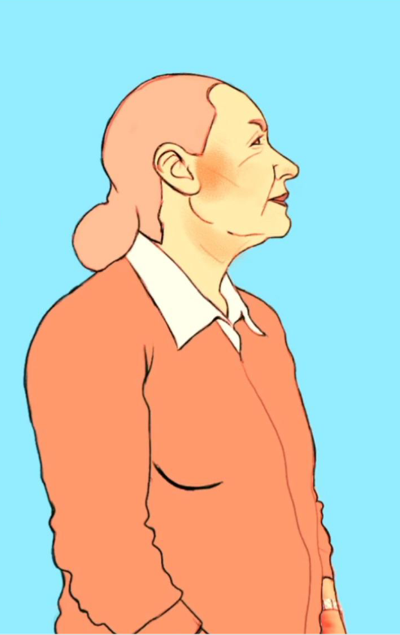
Introduction
We as a team were appointed to the Whisper Down The Lane project for ultimately transitioning the 2D video supplied by the client within a 3D scene in Virtual Reality format.
This was requested for further showcasing the amazing rotoscoped art style and the overall narrative of passing on important information which eventually loses its original message, also known as the Transmission Chain Experiment.
The client chose Virtual Reality as its platform for their established video from a 2D format to increase the immersive qualities of the message and the visual qualities of the original source material such as making the aesthetic appear more 3D and portraying the story clearer.

Slide 3
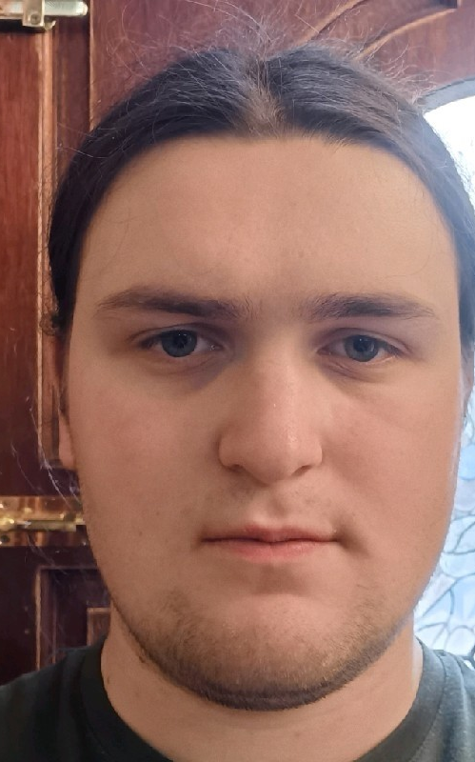
Lyon Simic
Education: Digital Art for 3D Games and Media Bachelor Honours Degree Graduate with interests in 3D environment and texture art.
Research: Low-Poly Modelling, VR Development, Immersive Experiences, Procedural Textures, High-Poly to Low-Poly Baking, Level of Details and UV Texel Density.
Role: Team Leader of Whisper Down The Lane Aramco Project.
Summary: Started my game development journey in college where I studied Creative Media Production and Technology at Hopwood Hall obtaining a Level 3 Extended Diploma to obtain the basics of 3D modelling, UV unwrapping and importing assets into Unreal Engine 4. I then proposed higher education by doing a degree course at University Campus Oldham which allowed me to build upon what I originally learned and now my learning journey is still ongoing from this Game Development Bootcamp course where I can finally obtain my Unity Associate Certification.

Slide 4
Alexander 'Alex' Burton
Education: Computing BsC from Edge Hill University.
Research:
Role: Programmer of Whisper Down The Lane Aramco Project
Summary:

Slide 5
Daniel Meakes
Education:
Research:
Role:
Summary:

Slide 6
Jinhao Zhang
Education:
Research:
Role:
Summary:

Slide 7

Methodology
Step 1

Slide 8

Conclusion
Outcome

Slide 9

Evaluation
What went well?
What would you do differently next time?
What would you change?
What did you enjoy the most?

Slide 10


Thank you for listening!
Any
questions?
0161 686 5770
info@in4group.co.uk
Twitter @IN4Group
www.in4group.co.uk

